Slide 1
類神經網路 HW1
姓名:李承穎
學號:111618502

Slide 2
Index
Topic
Flow Design
Data Prepare
Teachable Machine Train
Model Apply
Train with Pytorch
Github repo

Slide 3


Topic
使用Teachable Machine Image project來辨識圖像為神奇寶貝或是數碼寶貝

Slide 4
Flow Design
Data Prepare
Train Model
Test Model

Slide 5
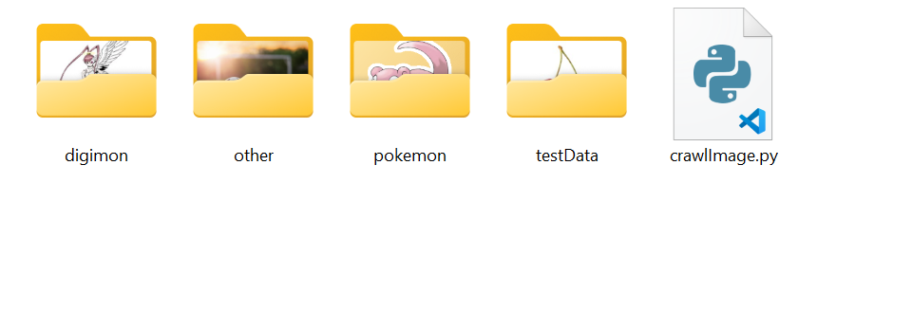



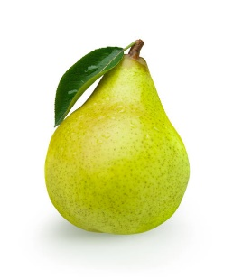


Data Prepare
Training Data
Test Data

Slide 6
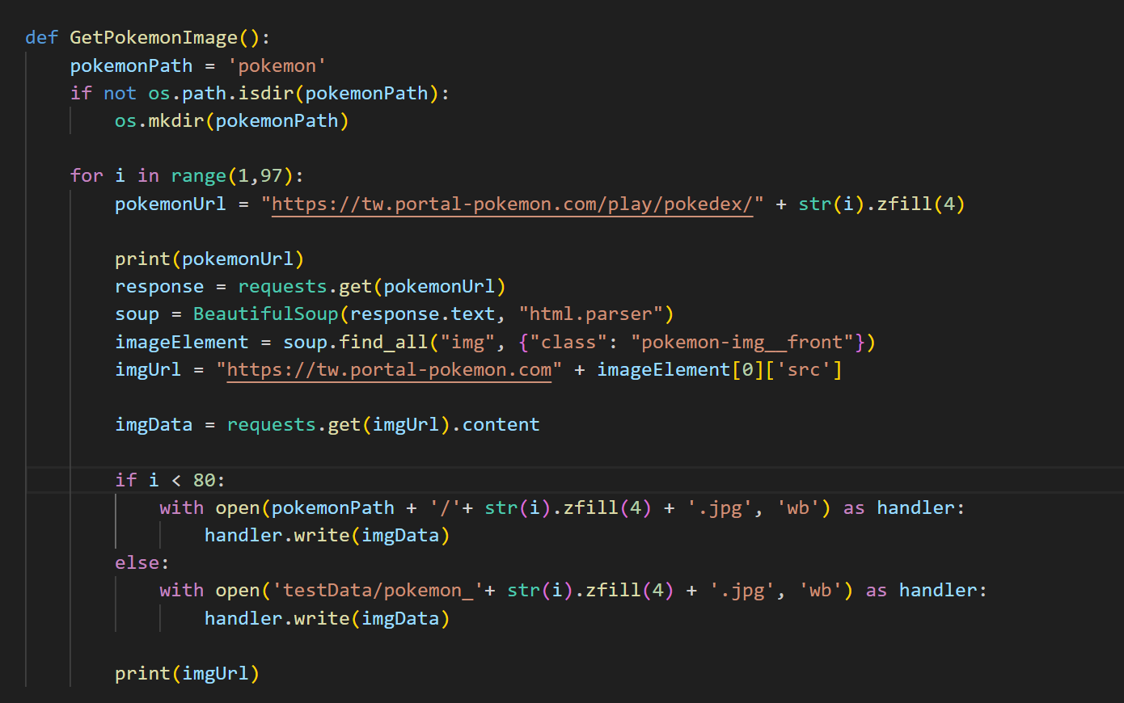
Data Prepare - Pokemon

Slide 7
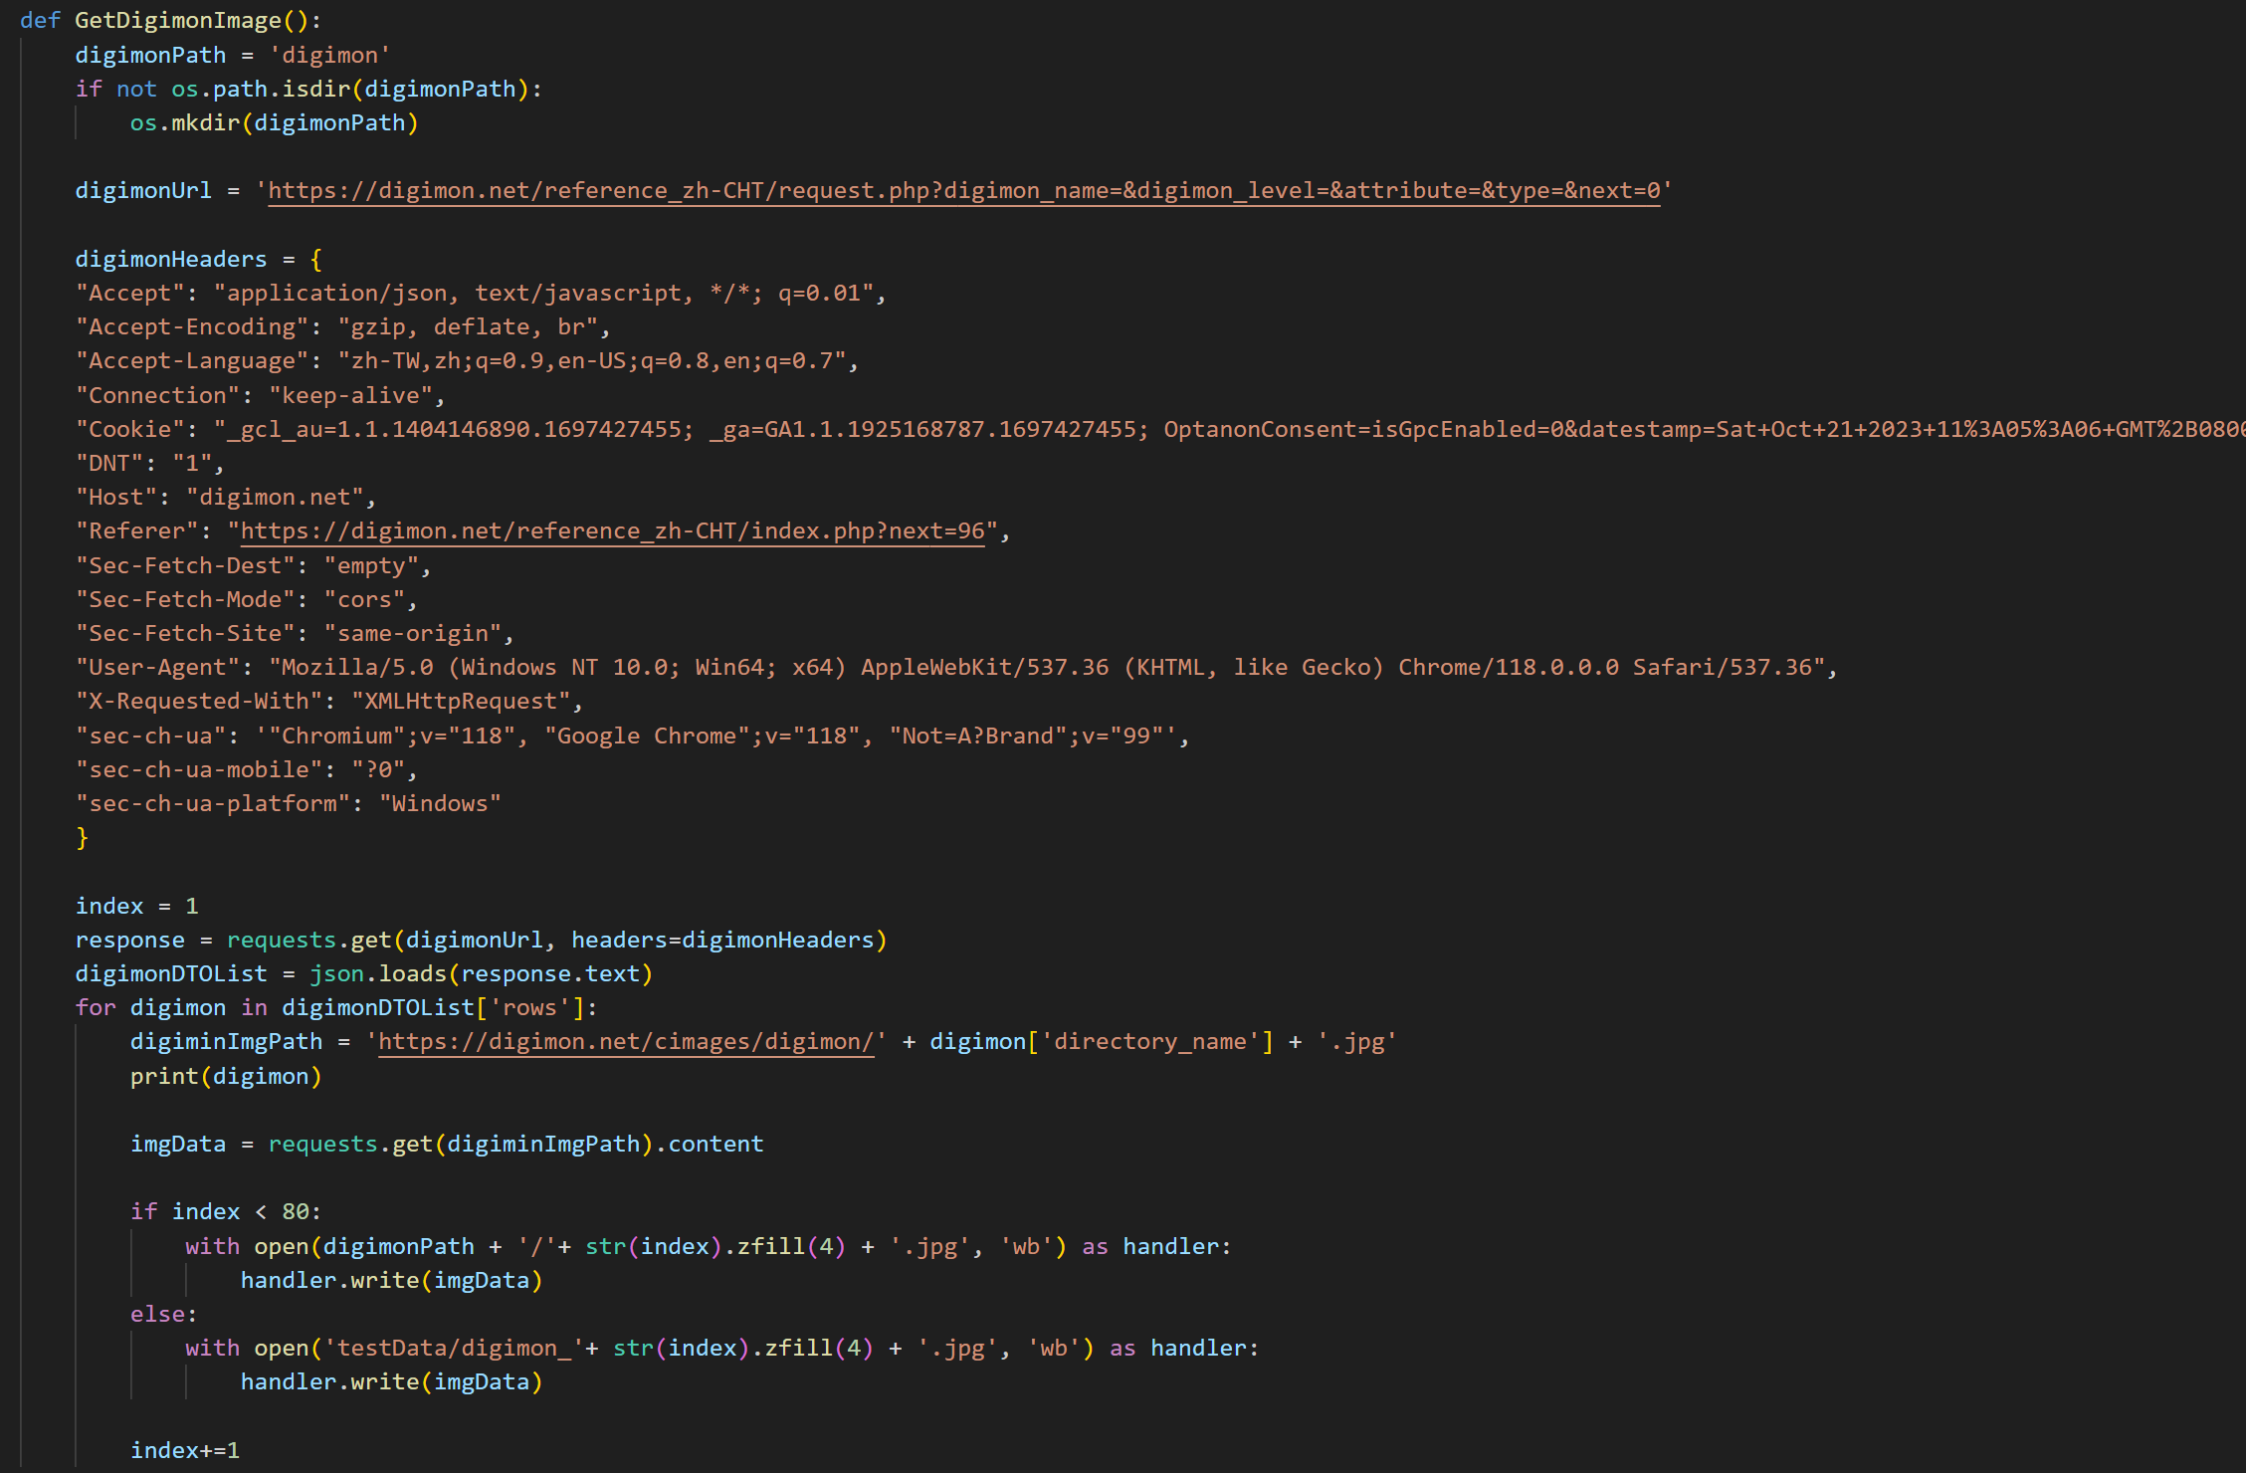
Data Prepare - Digimon

Slide 8
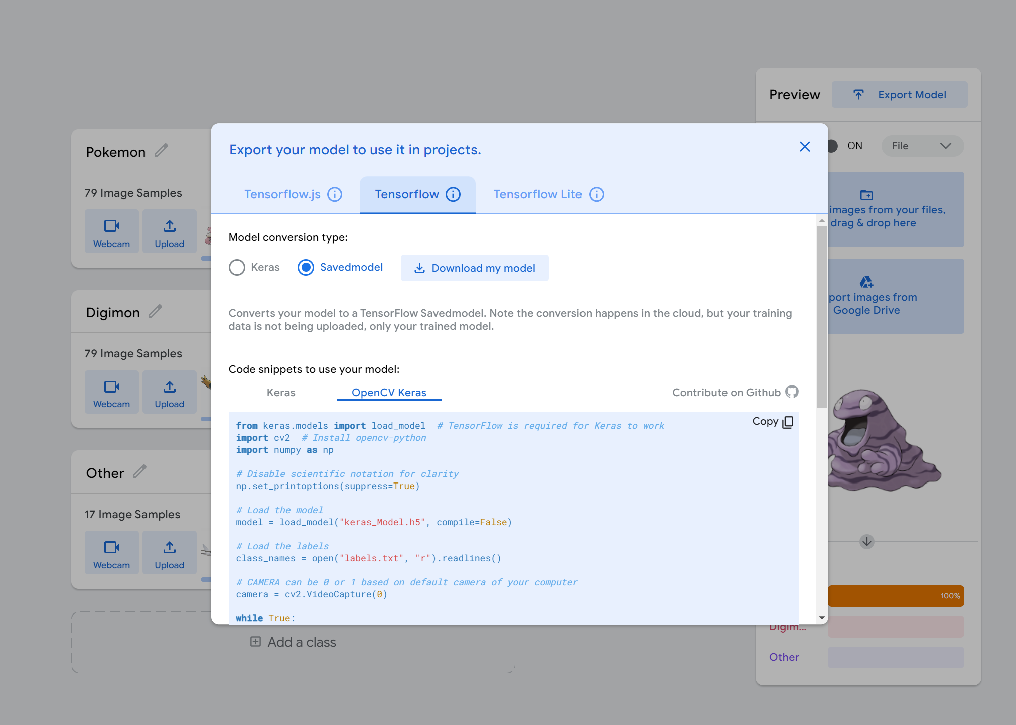
Teachable Machine Train

Slide 9
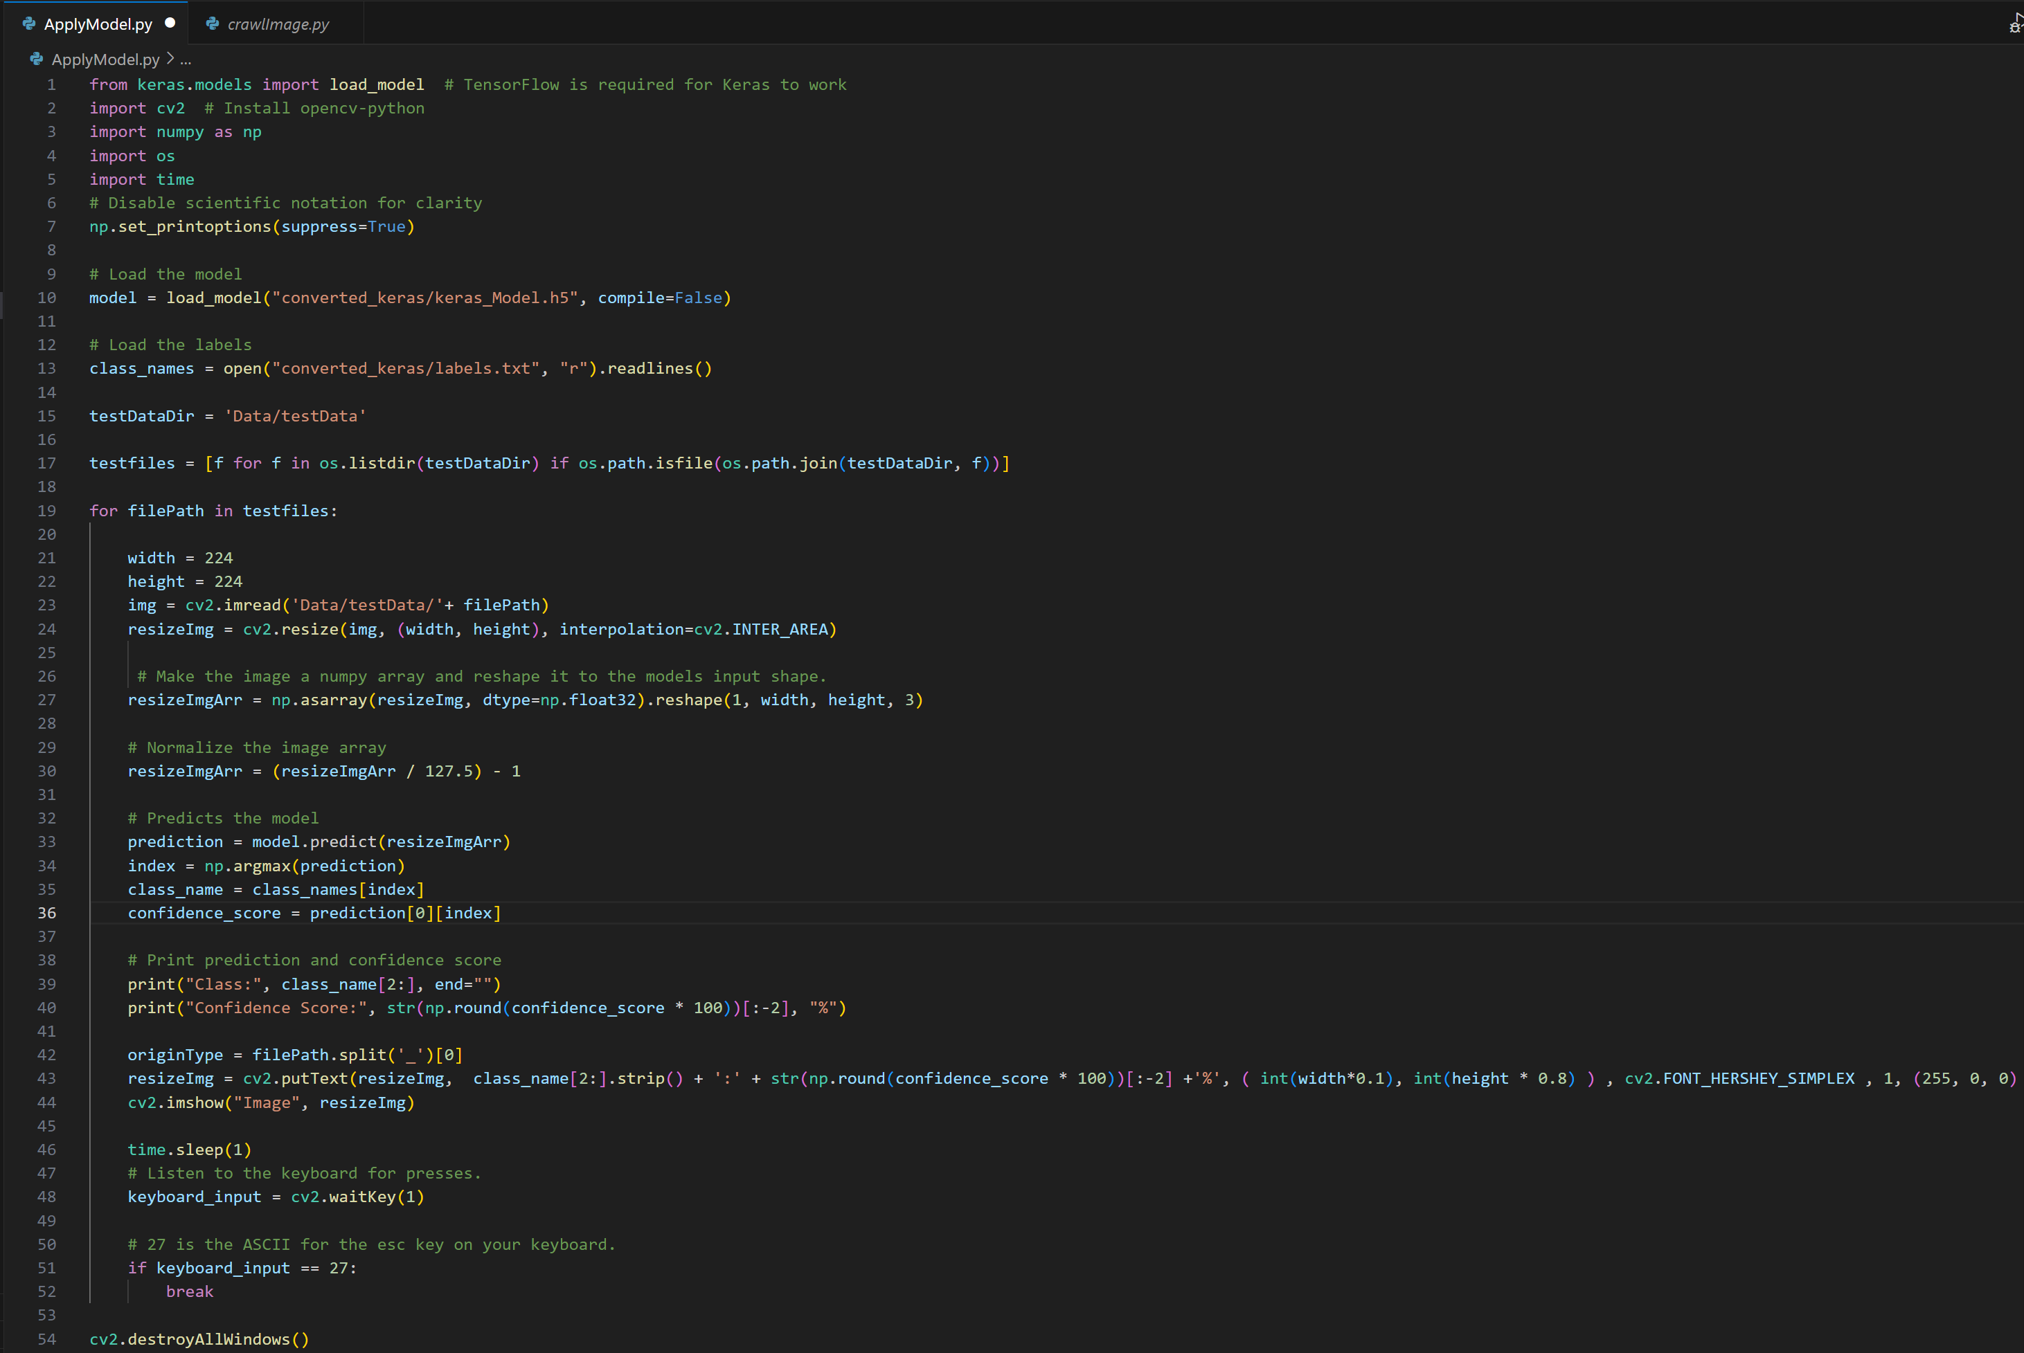
Model Apply

Slide 10
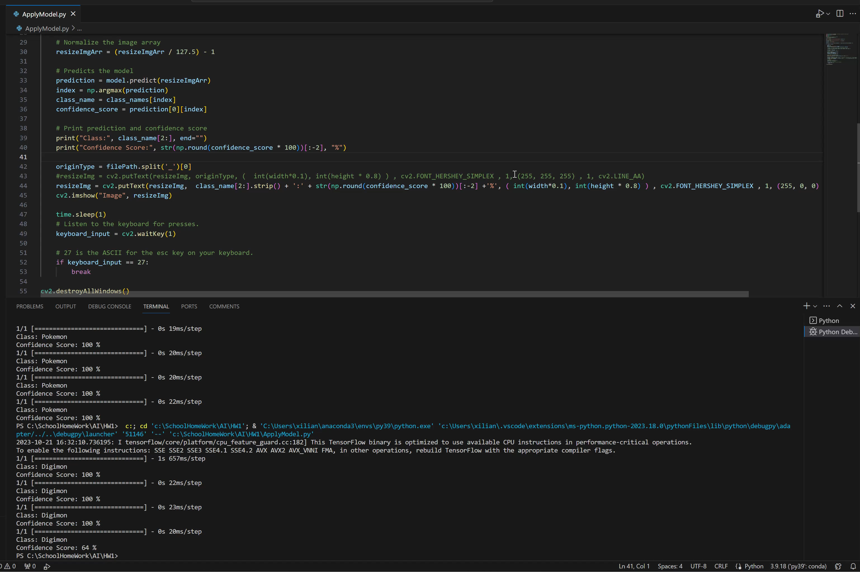
Demo

Slide 11
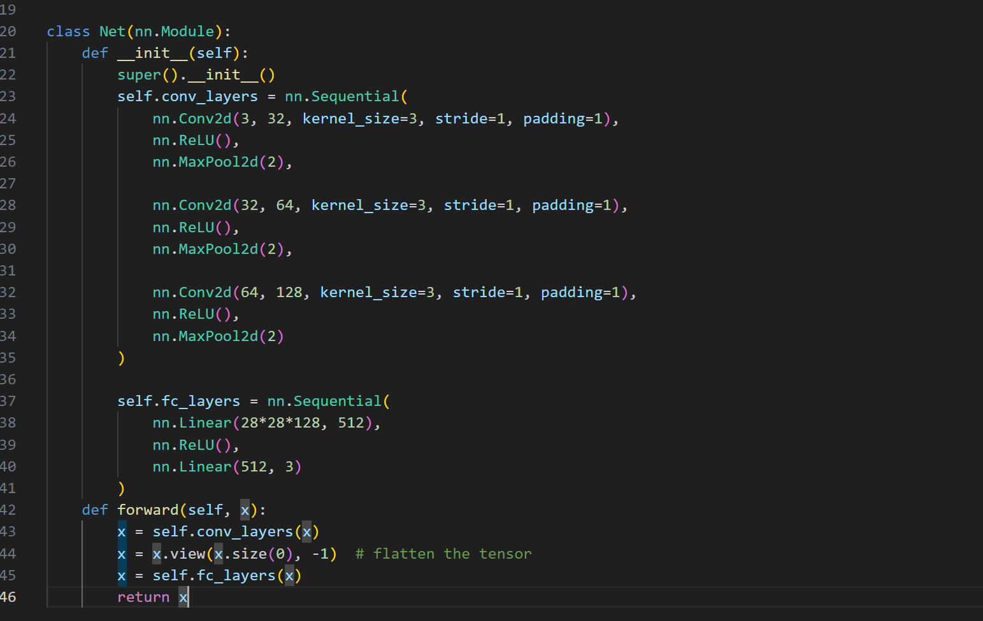
Train with Pytorch - Module

Slide 12
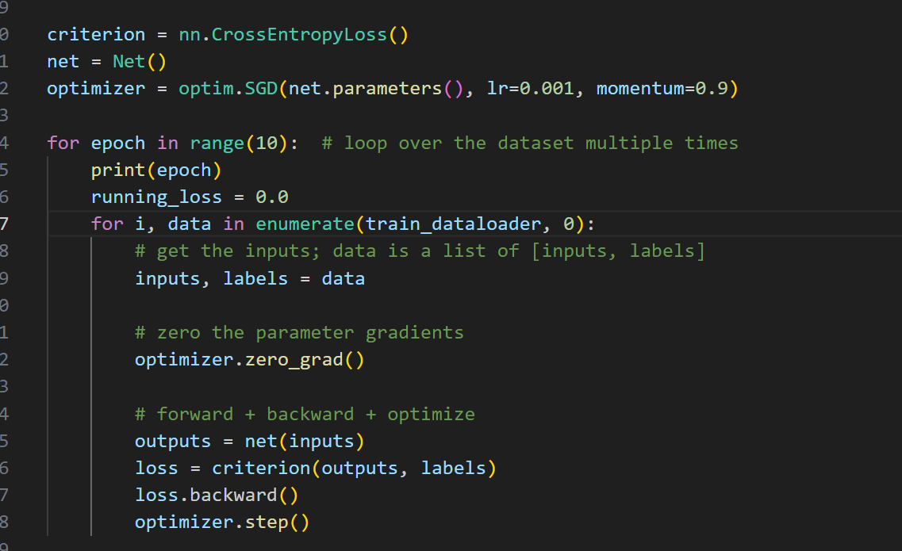
Train with Pytorch - Train

Slide 13
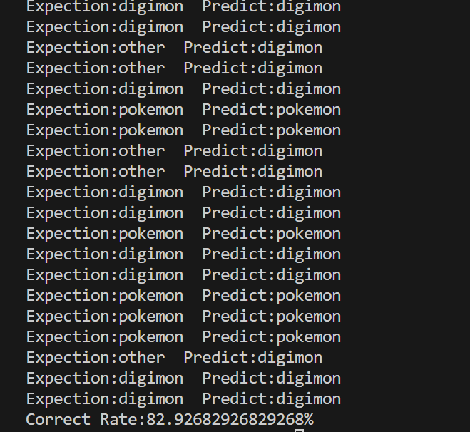
Train with Pytorch - Result

Slide 14
Github repo

